Slide 1
Spring Cloud
Components of Spring cloud

Slide 2
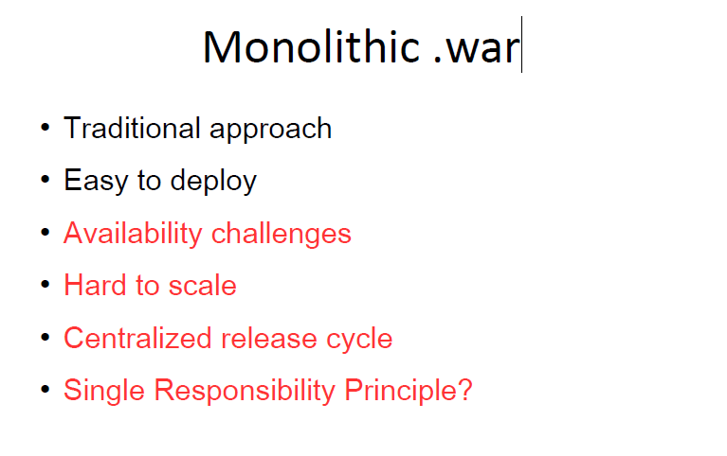
Monolithic

Slide 3
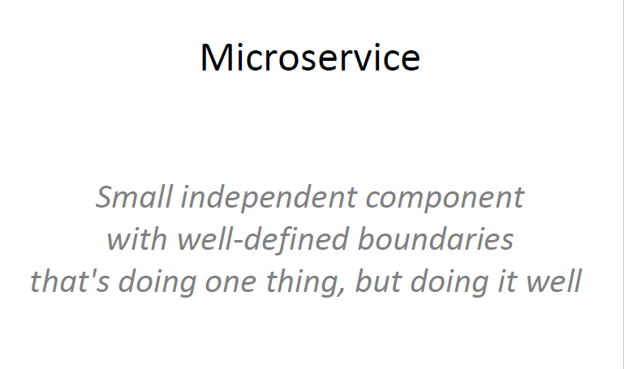
What are micro services ?

Slide 4
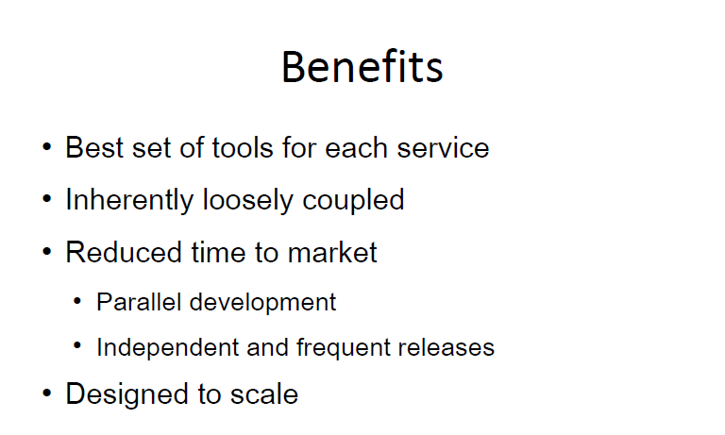
Advantages

Slide 5
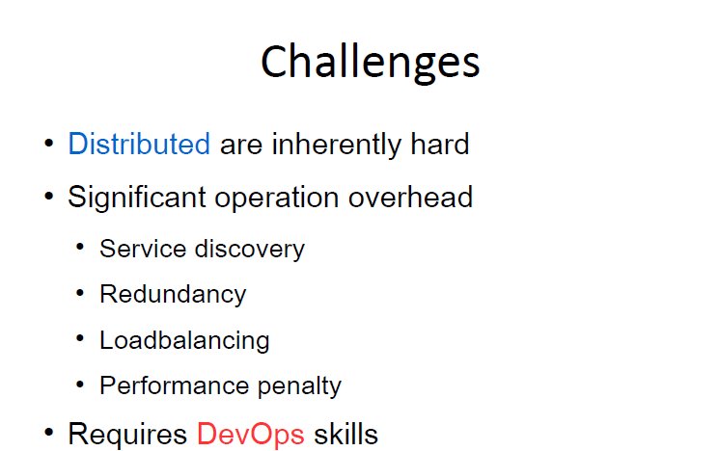
Challenges

Slide 6
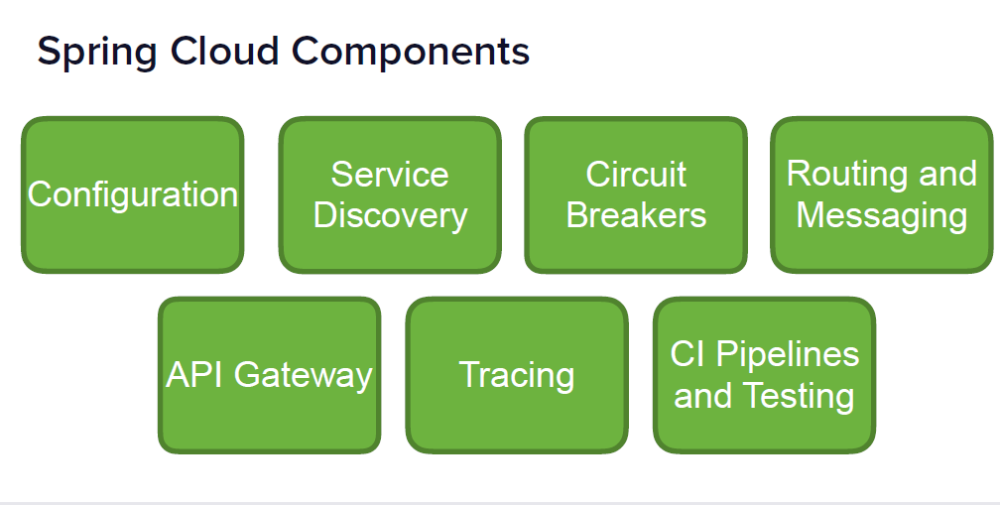
Spring Cloud Components

Slide 7
There are more…..
• Spring Cloud Bus
• Spring Cloud Stream
• Spring Cloud Data and Task
• Spring Cloud AWS
….and more

Slide 8
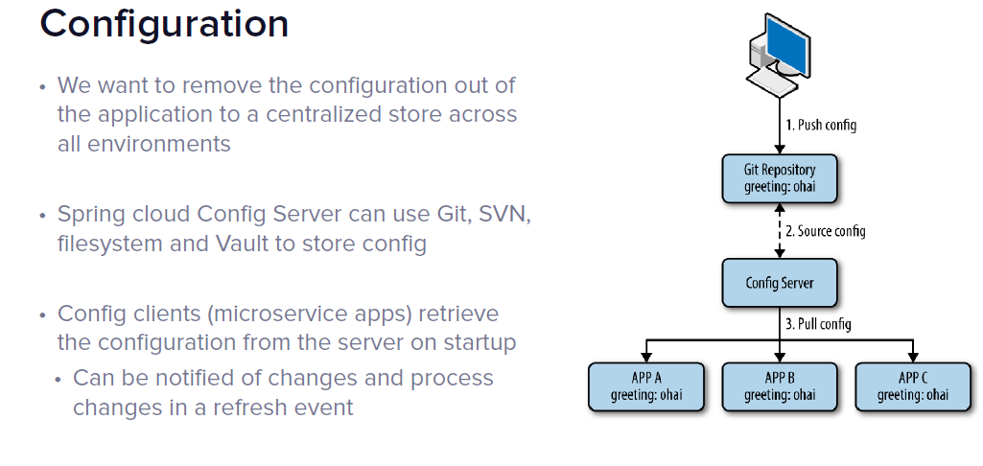
Configuration- Spring-Cloud-Config

Slide 9
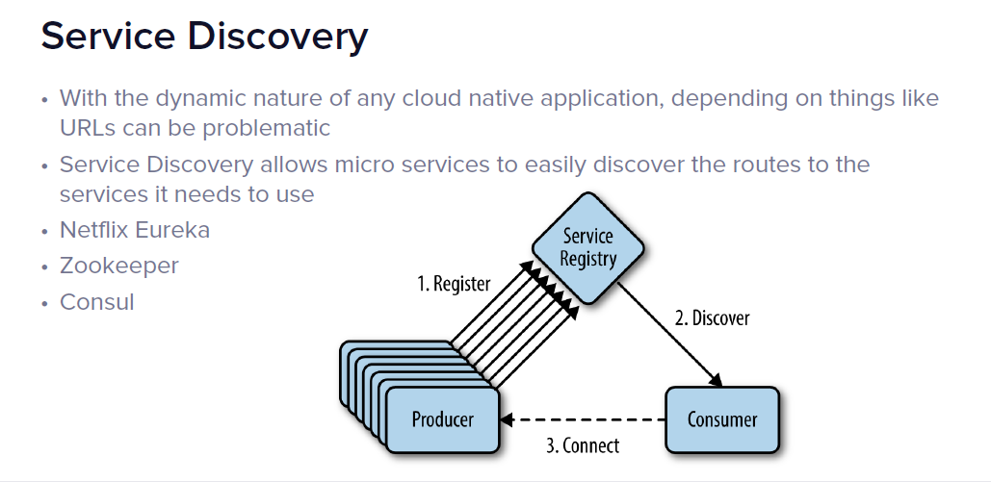
Service Discovery

Slide 10
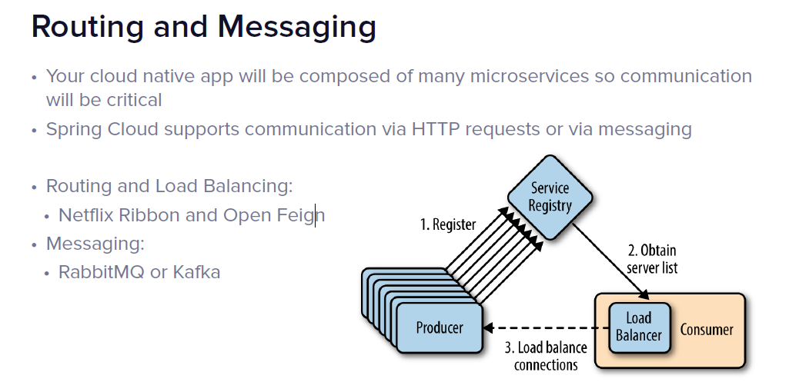
Routing and Messaging

Slide 11
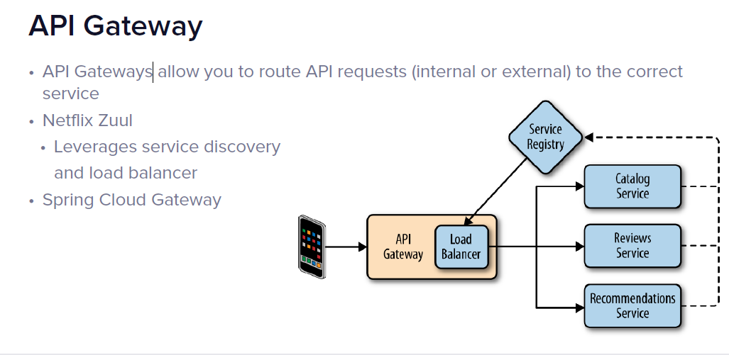
API Gateway

Slide 12
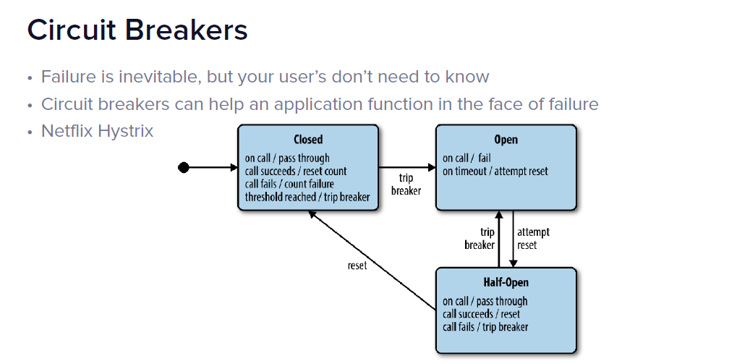
Circuit Breaker

Slide 13
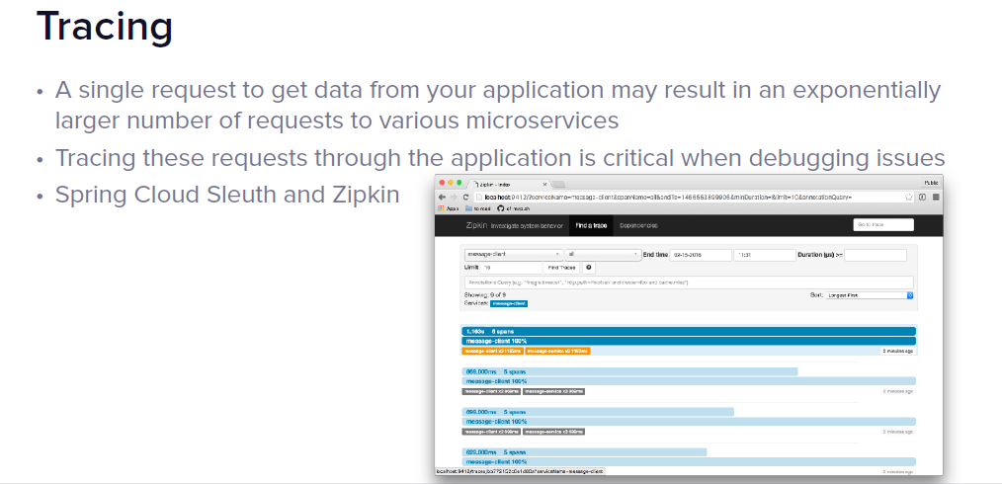
Tracing

Slide 14
Circuit Breaker

Slide 15
Circuit Breaker

